Slide 1
UDDI

Slide 2
Overview
Universal description discovery and integration enables business transactions on the web.
Not a standard body, joint initiative.
Member companies develop open specification and implementations of universal business registry (UBR).→ place for companies to register its businesses and services.
Not run by any one company.

Slide 3
UDDI Types
White pages
  Description about business & services.
  D-U-N-S 9-8 identification sequence
  Thomas registry identification scheme
Yellow pages
  Categorization as per industry-standard taxonomy
  NAICS North American Industry Classification System
  UNSPSC United Nation Products and Services Code System
Green pages
  Technical information catalogue
Blue pages
  UDDIe

Slide 4
Issues of UDDI
How organizations identifies each other
How describes themselves and services offer
How narrow down service providers that best fit its needs
How to obtain accurate detailed description of service
How to determine the mechanisms available to conduct e-business transactions
How could realize all the above using programmatic interfaces

Slide 5
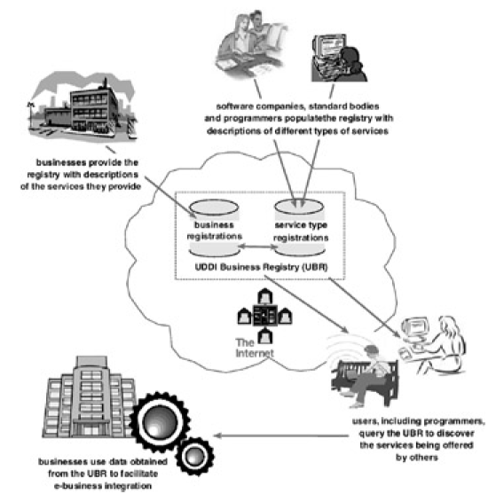
How UDDI works

Slide 6
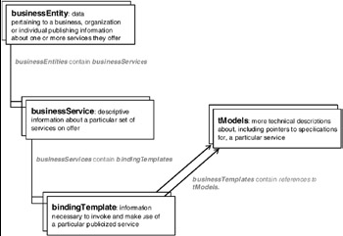
4 key data structures

Slide 7
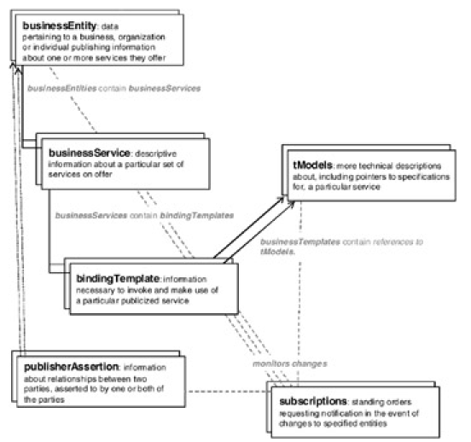
2 additional structures

Slide 8
UDDI xml data structures
businessEntity
businessService
bindingTemplate
tModel
publisherAssertion
subscription

Slide 9
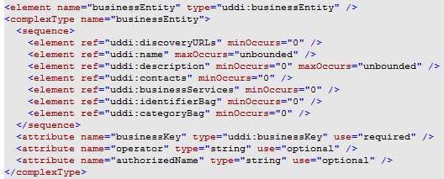
1. businessEntity

Slide 10
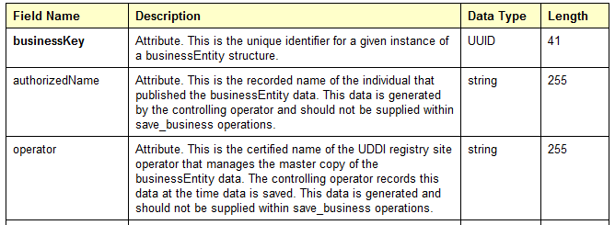
businessEntity…

Slide 11
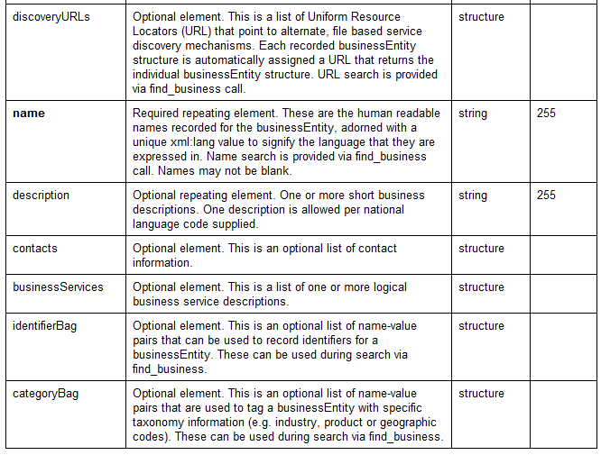
businessEntity…

Slide 12
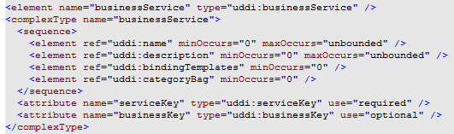
2. businessService

Slide 13
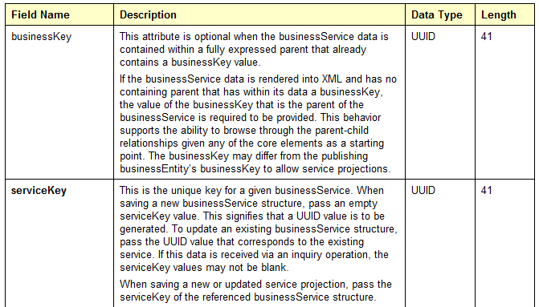
businessService…

Slide 14
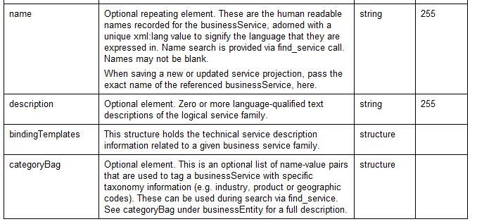
businessService…

Slide 15
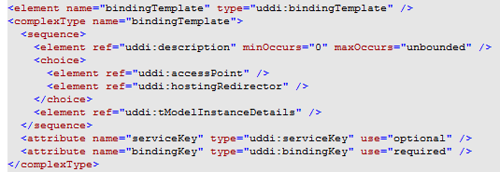
3.bindingTemplate

Slide 16
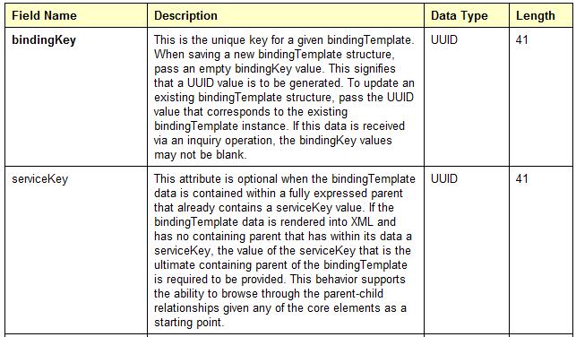
bindingTemplate…

